Slide 1
Technology Applications for Preventive Medicine and Health Promotion in Viet Nam

Slide 2
Contents
Introduction Vietnam
Overviews
Problems & Challenges
Successful case

Slide 3
1. Introduction

Slide 4
Vietnam Profile
Capital: Ha Noi
National day: 02/9
Area: 329.560 km²
Population: 96.2 M
Provinces: 63
Vietnam located in Southeast Asia
Notes:
Nation: 54 and Kinh (86,2%)
Total main land area: about 329.560 km²

Slide 5
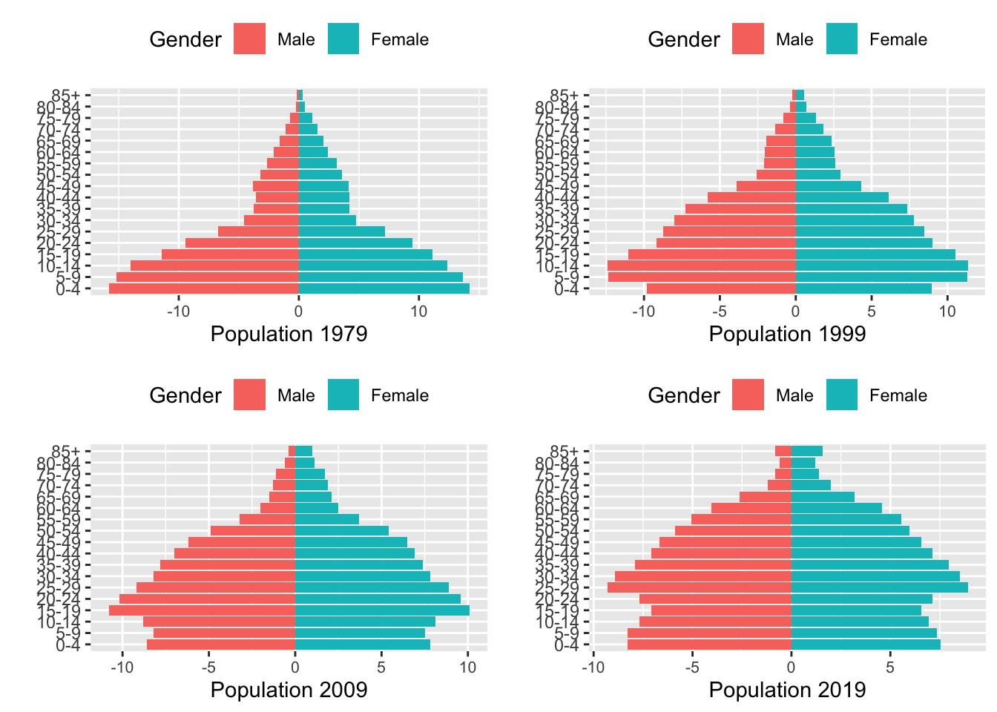
Notes:
Nation: 54 and Kinh (86,2%)

Slide 6
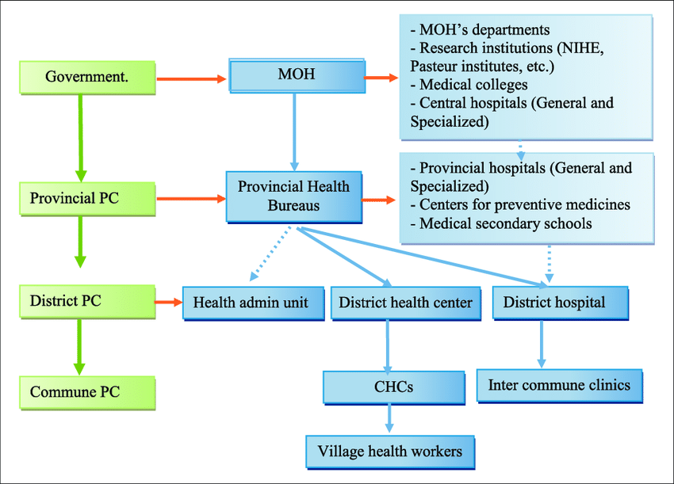
Health’s System
Notes:
PC: people committee
CHC: commune health centers

Slide 7
National Programes
1. Health & Population Target Programe
Prevent of some dangerous ID & common NCDs
Expande Immunization
Population & Development
Food safety
Prevention & Control HIV/AIDS
Safe Blood & Prevent Hematological Disease
Combine Civilian & Millitary Medicine
Management of Medical Communication
2. Development of local healthcare networks
Notes:
Programe: develop local heatlth

Slide 8
2. Overviews

Slide 9
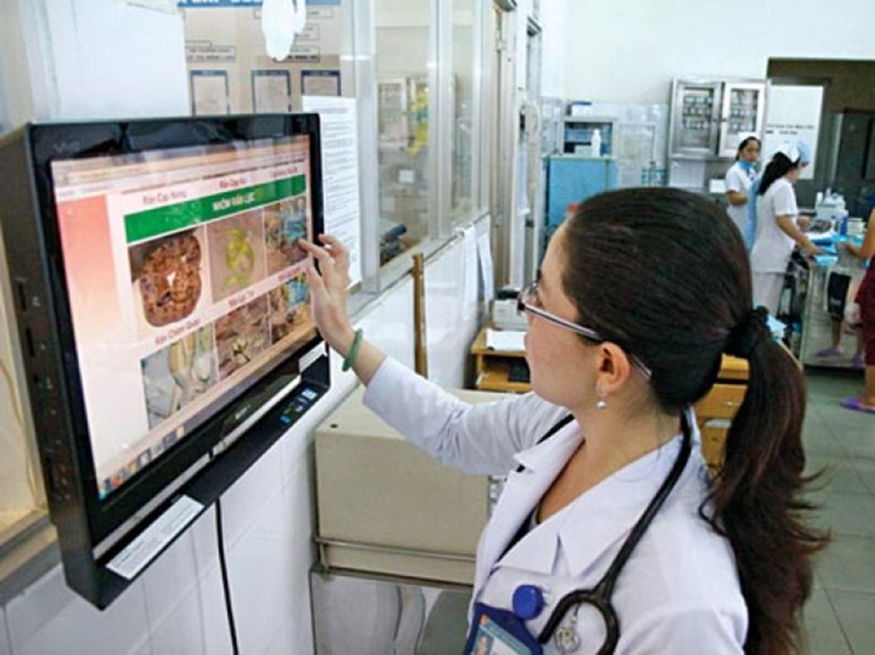
Overview
Technology application for Healthcare system develop rapidly, economically, effectively and improve community health
Medical facilities are constantly invested, upgraded and improved information technology systems.
Notes:
Open eLIS

Slide 10
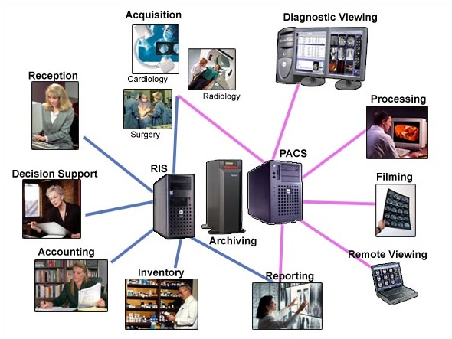
2.1. Hospital Information System (HIS)
It’s an optimization tool in excutive management, treatment, research and training, statistics, prevention… at hospitals.

Slide 11
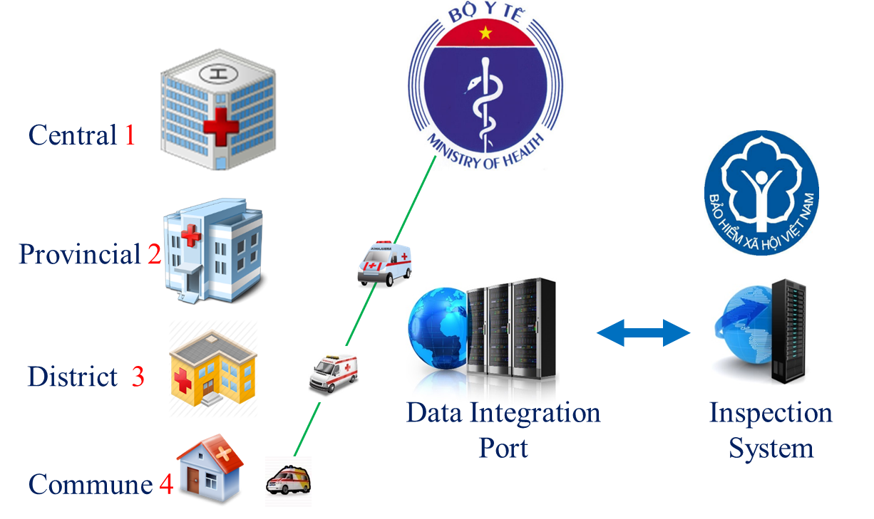
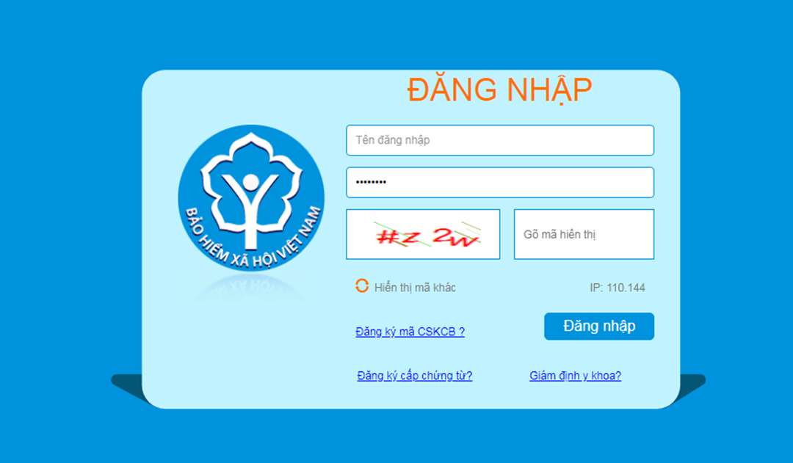
2.1. Hospital Information System (HIS)
Vietnam Social Insurance Agency
1,000,000 transactions/day
21.808 msg/sec ~ 1.884.211.200 msg/day
Notes:
Vietnam Social Insurance Agency (99,5% Hosp)

Slide 12
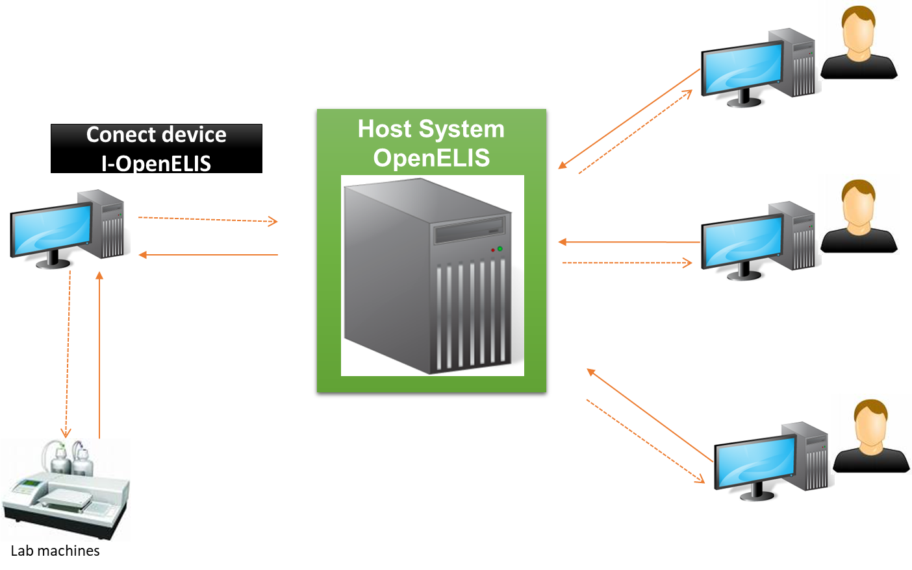
2.1. Hospital Information System (HIS)
Open eLIS is an open-source electronic laboratory information system.
It was developped in the U.S. Public health laboratory system and support for Vietnam to deloy in laboratory facility nationwide from 12/2007.
Application LIS showed significant improvement to ensure the quality of test, specifically on reducing errors in the testing results down to 20-25%.
Open eLIS
Notes:
Kiểm soát chất lượng xét nghiệm qua từng giai đoạn: trước, trong và sau xét nghiệm. Quản lý thông tin và kết quả của người xét nghiệm.

Slide 13
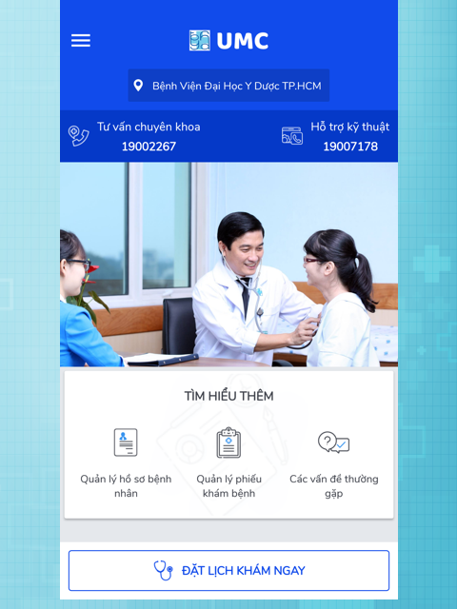
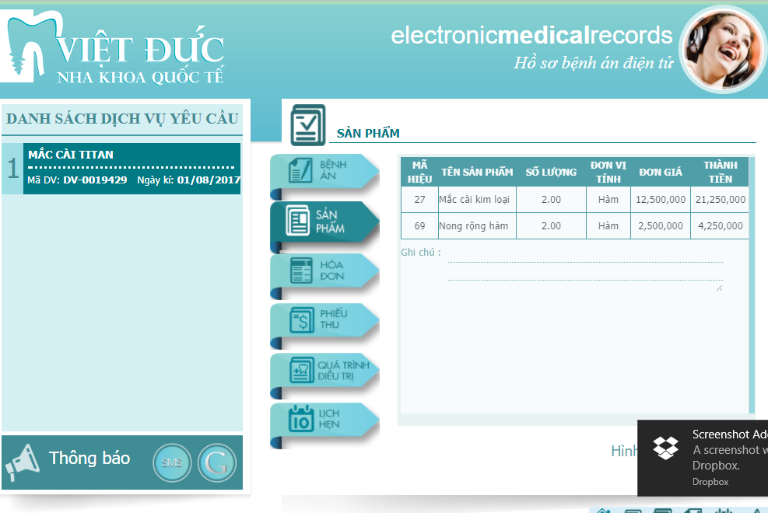
2.2. Electronic medical records (EMR) & Picture Archiving and Communication System (PACS)
4 Central Hosp; 2 District Hosp
2030: 100% Hosp have EMR
Notes:
EMR are an software used to replace paper medical records in patient information management, diagnosis, test results, treatment procedures ... with many advantages in summarize data for treatment and research support.
PACs use to store, transmit and receive images on the computer information network of the Department of Imaging, in which images are taken from devices: ultrasound, X-ray, tomography, resonance from the nucleus ...

Slide 14
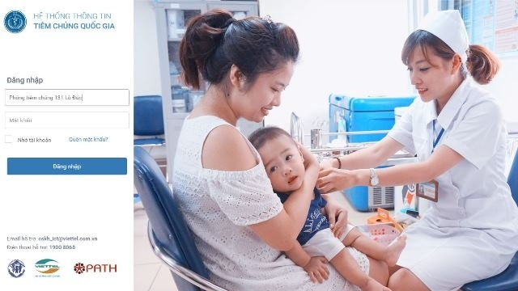
2.3. Vaccination management information system
Completing the connection of drug supply facilities
Personal electronic health records management
Manage personal vaccination system (11.183 CHCs - 99%)
Notes:
CHC: commune health centers
Building vaccination management information system: Implementing in 2017 and Completing in 2019

Slide 15
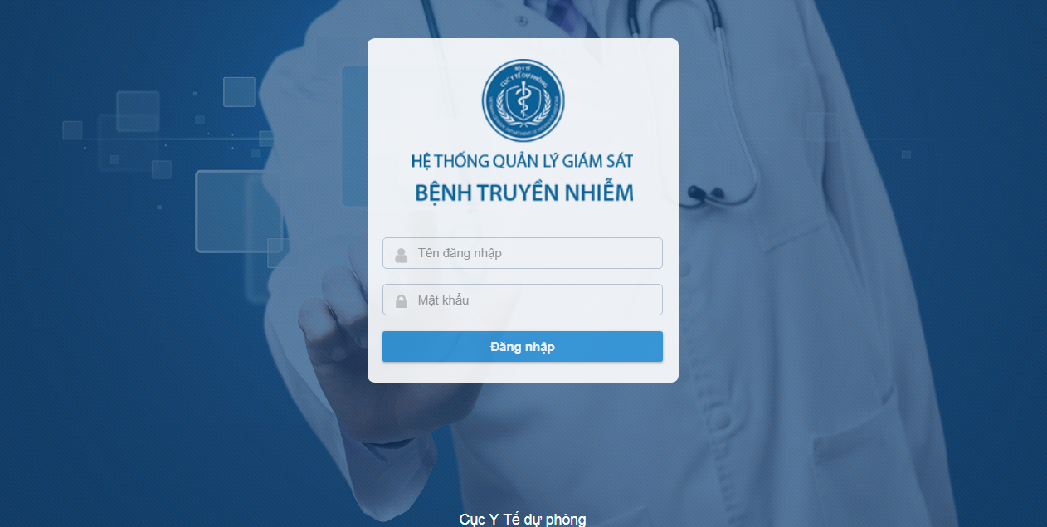
2.4 Electronic communicable disease surveillance system (eCDS)
eCDS is deployed nationwide to report and manage cases with 42 infectious diseases. Each health facility has its own account to log into this system.
The software system has 9 modules
- Managing shared lists
- Management of disease cases
- Manage outbreaks
- Manage weekly reports
- Manage monthly reports
- User administration
- Statistics, report output
- Analysis chart
- Map of the distribution of cases

Slide 16
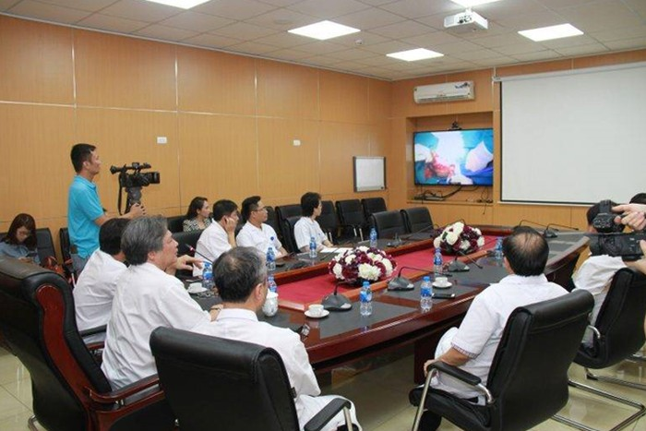
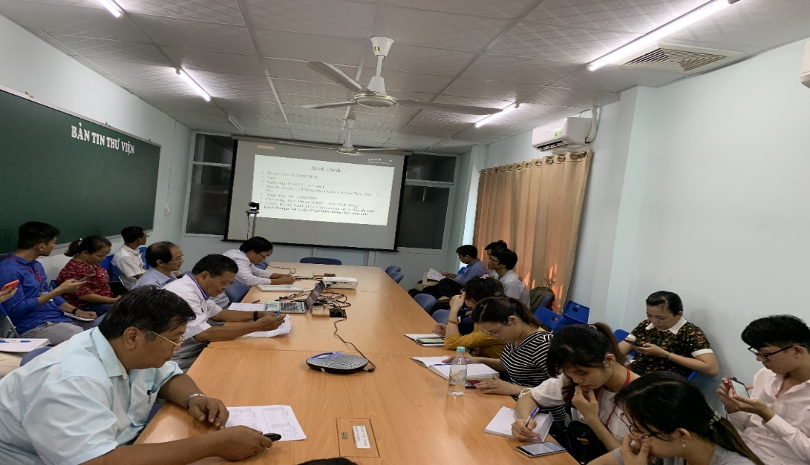
2.5. Telehealth
Teleconsulting
Telediagnostics
Teletraining
(Mobile app)
Telemedicine application at the hospital enhances the ability to exploit common resources in the health sector: equipment, experts, data. Telemedicine can be classified into: Teleradiology, Teleconsulting, Telediagnostics, video-conferencing, Remote education system, e-learning. Patients can be cared for anywhere and anytime - that is the superiority of telemedicine.

Slide 17
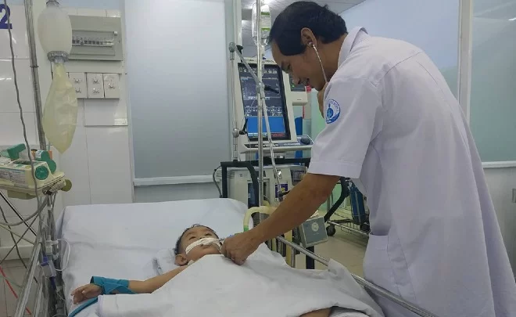
Successful case
A 2-year-old boy who had hand-foot-mouth disease
Telediagnostics, video-conferencing: Ca Mau Obstetrics and Pediatrics Hospital in the southernmost province of Ca Mau sent videos and test results to Children Hospital 1 in HCM City’s of.

Slide 18
3. Problems and Challenges

Slide 19
Problems and Challenges
Software: Asynchronous and that does not respond to the requirements.
Backup device is not available to replace when the main device has a problem; Backup and recovery data solution hasn’t completed
Information technology infrastructure: deficiency, isn’t commensurate with the scale of operation and haven’t invested much in information security
The most difficulty is lack of Specialist’s IT who trained and have good experiences
Notes:
Infrastructure IT: Backup device, Recovery data

Slide 20
Thank you for your attention

