Slide 1
Overview from the islands of Kiribati on technology intervention to health preventive medicine and health promotion
By Mr Tarau Bauia
IT Specialist
Ministry of Health and Medical Services
Graduated from AUT with
Honoured Master in Service Oriented Computing

Slide 2
Presentation Overview
Country background
Public Health Promotion and Medicine Preventive
Overview on the past few days presentations.
Key issues and challenges
Future plans and strategic recommendations
Conclusion

Slide 3
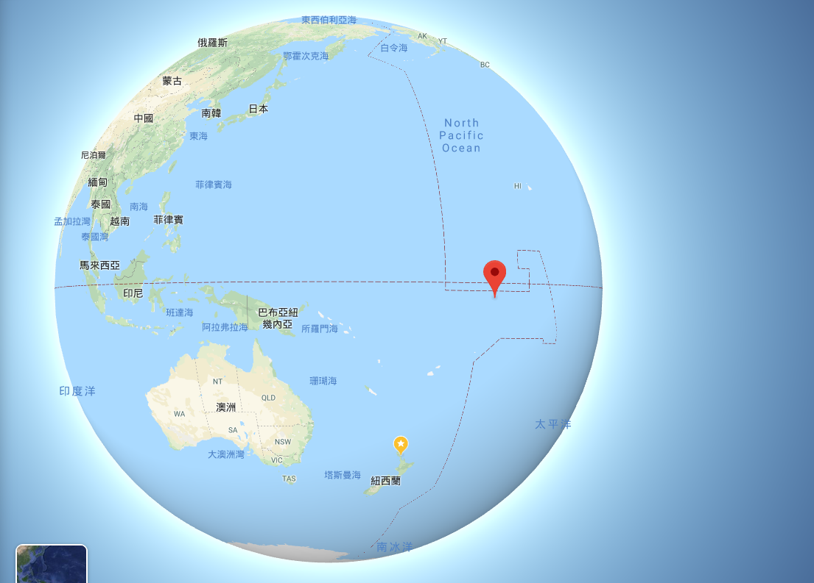
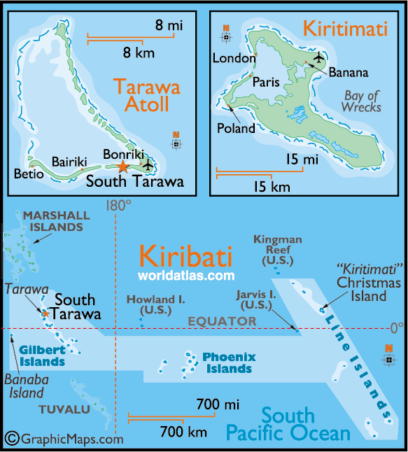
Kiribati facts:
Population is around 117,751
Concentrated population areas
Tarawa and Kiritimati (Christmas Island)
Islands are scattered in the water
Doctors are concentrated on Tarawa,
2 Doctors at Kiritimati
1 Doctor at Tabiteuea
No doctors at the rest of the islands but MA
Mobile and Internet are mainly use in Tarawa and Kiritimati island
VSAT is used in a few of the atoll islands

Slide 4
Public Health Promotion and Medicine Prevention
Radio broadcasting awareness
Road show and drama
Poster and pamphlets
Notes:
From our limited ways of interacting with the public we have this kind of NCD record

Slide 5
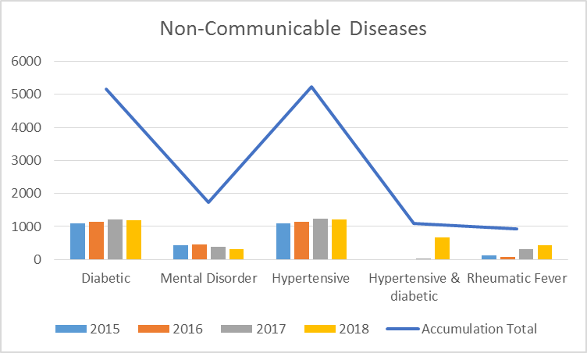
Non-communicable diseases
Notes:
It shows an inconsistency in the figures from 2015 to 2018, this can be a challenge because we manually collect the information from clinics

Slide 6
Key issues and challenges with the technology
Remoteness of the islands
01
Internet connection on the islands
02
Internal health network infrastructure
03
Digital literacy of the citizens
04
Responsible officer for digital health promotions
05

Slide 7
Overview on the past few days presentations
Overwhelmed with so many innovations
Ideas that are collaborated from research, universities to the market place.
Technology is used to empower all kind of people
Technology is the main catalyst to develop smart and interactive solutions.
So technology can be helpful to my country in so many ways!!

Slide 8
Healthcare services without any boundaries
Hospital to Hospital relationship
Doctor to Doctor relationship
Patient to Doctor relationship
Patient to Close Family to Doctor relationship
Innovators, system developers to Doctors
System developers to Patients
Notes:
Sharing of values and value co-creation

Slide 9
Implications of unbounded healthcare
Improved on intangible healthcare services globally
Healthcare to become a Service Dominant Logic
Value co-creation between the consumers and the healthcare service providers
Telemedicine, online health consultation enabled.
Participation and involvement in global health awareness and clubs.
More choices for a consumer/patient
A patient is becoming a consumer in the new health era.

Slide 10
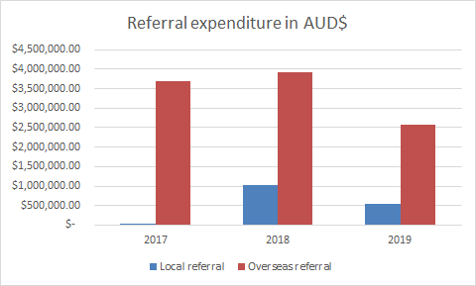
Key Issues and Challenges with unbounded healthcare
Cost of the service
Efficiency, security and Integrity of the service
Can the system mitigate impersonation attack?
Will the GP provide a proper prescription without/less consequences/side effects than our local GP?
Will we be able to give a genuine service rating to help future users and customers?
Will we be able to upload data and information to the internet like blood sugar, etc effectively?

Slide 11
Future plans and strategic implementations
To improve internet connection at our respective hospitals
To improve all health campus network infrastructures to improve data collection
E-Health development and electronic medical recording system implementation
To be able to provide advisory, auditing and rating on any healthcare service delivery platform in the future to our citizens

Slide 12
To sum up
Health promotion through technology is not yet implemented in my country.
We are in a process to adopt technology as our way forward to improve our health service delivery to our people.
Looking forward to collaborate with health service offerings when provided by other developed countries at an affordable rate.

Slide 13
KAM RABA

